Slide 1
UPPER SIXTH ARTS
GEOGRAPHY
Practical Work 1: Nearest Neighbour Analysis
Nearest Neighbour Analysis
Notes:
Good morning, class, and welcome to our geography lesson. I am your geography teacher, Mr Kamdem. Today we are starting Practical Work 1: Nearest Neighbour Analysis.

Slide 2
CLASS INFO
Class, Chapter and Duration
Class | Upper Sixth Arts
Chapter | Module 5: Understanding and managing settlement dynamics across the world in general and Cameroon in particular
Duration | 2 periods (2 × 50 minutes)
Notes:
This lesson is for Upper Sixth Arts. It belongs to Module 5: Understanding and managing settlement dynamics across the world in general and Cameroon in particular. We shall need 2 periods to cover it.

Slide 3
IDENTIFICATION
Lesson Identification
Topic | Rural Settlement
Sub-topic | Rural Settlement on the Landscape
Lesson | Practical Work 1: Nearest Neighbour Analysis
Notions / Concepts | Nearest neighbour index, Rn, clustered, random, regular, mean distance.
Syllabus focus | Meaning, formula, interpretation scale, importance and limitations of the nearest neighbour index; worked examples.
Competence | Learners are able to calculate and interpret the nearest neighbour index of a settlement pattern.
Notes:
Our topic is Rural Settlement, and the sub-topic is Rural Settlement on the Landscape. The key notions we shall use today are: nearest neighbour index, Rn, clustered, random, regular, mean distance. At the end, you should be able to do this: learners are able to calculate and interpret the nearest neighbour index of a settlement pattern.

Slide 4

HOMEWORK CORRECTION
Correction of the Homework
Question (Lesson 5: Settlement Distribution and Pattern):
On a topographic map, describe the settlement pattern of one area.
Notes:
Before we start the new lesson, let us correct the homework I gave you at the end of Lesson 5: Settlement Distribution and Pattern. The question was: On a topographic map, describe the settlement pattern of one area. Take out your exercise books.

Slide 5
HOMEWORK CORRECTION
Correction: Possible Answer
Example: in the area studied, settlements are nucleated along the river and linear along the main road, while the hills are almost empty.
Notes:
Here is a good answer. Example: in the area studied, settlements are nucleated along the river and linear along the main road, while the hills are almost empty. Compare it with your own answer and correct your work in red.

Slide 6
LESSON PLAN
Lesson Plan
Correction of the homework
Objectives and recall
Real-life situation and action to take
Learning activities
Board summary
Evaluation, remediation and homework
Notes:
Here is the plan of our lesson today. First, we shall correct the homework. Then we shall look at the objectives and recall what you already know. After that, we shall study a situation from real life and the action to take, and do the learning activities. Finally, we shall copy the board summary, do the evaluation and the remediation, and I will give you the homework.

Slide 7
OBJECTIVES
Objectives
By the end of this lesson, you should be able to:
State the nearest neighbour formula.
Calculate Rn from map data.
Interpret Rn and give its limits.
Notes:
By the end of this lesson, you should be able to do three things. Number 1: state the nearest neighbour formula. Number 2: calculate Rn from map data. Number 3: interpret Rn and give its limits.

Slide 8
PREVIOUS KNOWLEDGE
Previous Knowledge
Patterns can be dispersed, nucleated or regular.
Distances are measured on maps with the scale.
Notes:
Let us first remember what you already know. Patterns can be dispersed, nucleated or regular. Distances are measured on maps with the scale. Keep this in mind, because we shall build on it today.

Slide 9
REAL-LIFE SITUATION
Situation in Real Life
Two learners look at the same map. One says the settlements are clustered; the other says they are random. The teacher says, "Let us measure, not guess."
Notes:
Listen carefully to this situation from real life. Two learners look at the same map. One says the settlements are clustered; the other says they are random. The teacher says, "Let us measure, not guess." Think about it, because I am going to ask you some questions.

Slide 10
REAL-LIFE SITUATION
Situation: Question 1
What is the problem in the situation?
Notes:
Question 1: What is the problem in the situation? Think for a moment, then raise your hand to answer.

Slide 11
REAL-LIFE SITUATION
Answer
The learners describe the pattern differently.
Notes:
Good. The learners describe the pattern differently.

Slide 12
REAL-LIFE SITUATION
Situation: Question 2
What tool can measure the pattern?
Notes:
Question 2: What tool can measure the pattern? Think for a moment, then raise your hand to answer.

Slide 13
REAL-LIFE SITUATION
Answer
The nearest neighbour index (Rn).
Notes:
Good. The nearest neighbour index (Rn).

Slide 14
REAL-LIFE SITUATION
Situation: Question 3
What does Rn = 1 mean?
Notes:
Question 3: What does Rn = 1 mean? Think for a moment, then raise your hand to answer.

Slide 15
REAL-LIFE SITUATION
Possible Answer
A random pattern.
Notes:
Good. A random pattern.

Slide 16
ACTION TO TAKE
Action to Take
Measure settlement patterns objectively with the nearest neighbour index.
Notes:
From this situation, the action we are working towards in this lesson is the following: measure settlement patterns objectively with the nearest neighbour index.

Slide 17
JUSTIFICATION
Justification of the Lesson
This practical work helps us to describe settlement patterns with numbers.
Notes:
Why is this lesson important for you? This practical work helps us to describe settlement patterns with numbers.

Slide 18
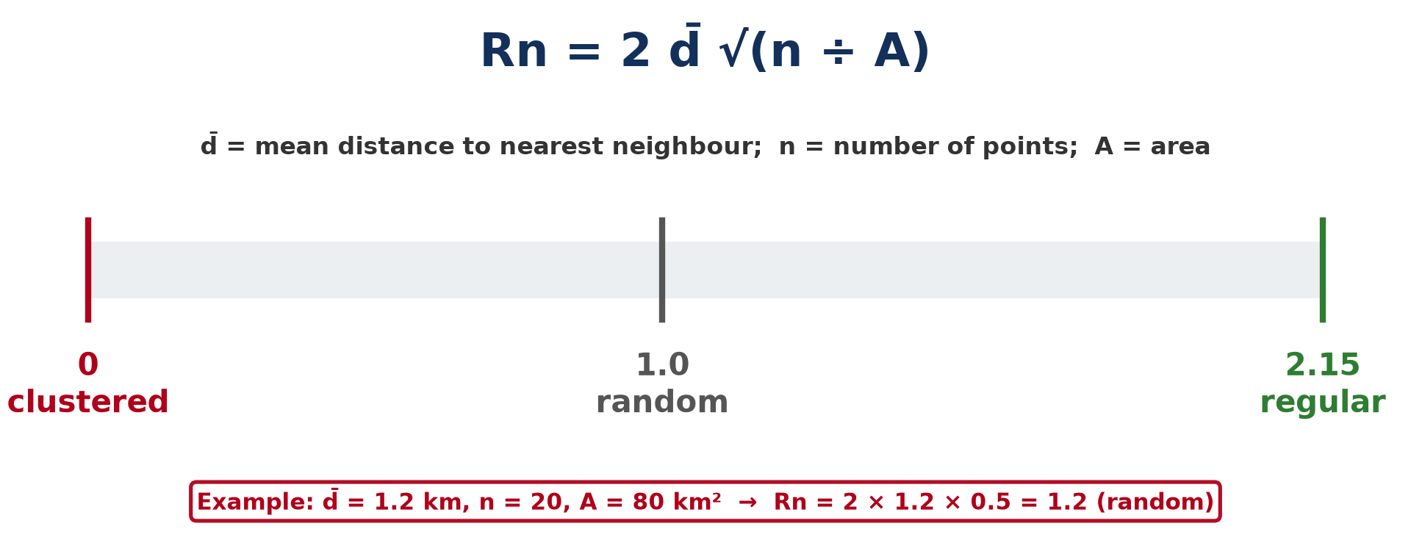
1. THE FORMULA
Activity 1
Formula and scale of the nearest neighbour index.
Notes:
Activity 1. Look carefully at this diagram: formula and scale of the nearest neighbour index. Observe every detail before I ask the question.

Slide 19
1. THE FORMULA
Activity 1: Question
What do Rn values of 0, 1 and 2.15 mean?
Notes:
Here is the question for Activity 1: What do Rn values of 0, 1 and 2.15 mean? Take one minute to think and write your answer in your rough notebook.

Slide 20
1. THE FORMULA
Activity 1: Answer
0 = clustered, 1 = random, 2.15 = perfectly regular.
Notes:
Let us check the answer together. 0 = clustered, 1 = random, 2.15 = perfectly regular.

Slide 21
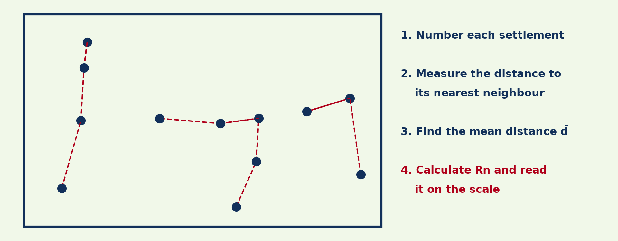
2. METHOD
Activity 2
Measuring the nearest neighbour distances.
Notes:
Activity 2. Look carefully at this diagram: measuring the nearest neighbour distances. Observe every detail before I ask the question.

Slide 22
2. METHOD
Activity 2: Question
What must you measure for each settlement?
Notes:
Here is the question for Activity 2: What must you measure for each settlement? Take one minute to think and write your answer in your rough notebook.

Slide 23
2. METHOD
Activity 2: Answer
The straight distance to its nearest neighbouring settlement.
Notes:
Let us check the answer together. The straight distance to its nearest neighbouring settlement.

Slide 24
3. CALCULATION
Activity 3
A worked example.
Notes:
Activity 3. Look carefully at this diagram: a worked example. Observe every detail before I ask the question.

Slide 25
3. CALCULATION
Activity 3: Question
15 villages in 60 km², mean distance 1.0 km. Find Rn.
Notes:
Here is the question for Activity 3: 15 villages in 60 km², mean distance 1.0 km. Find Rn. Take one minute to think and write your answer in your rough notebook.

Slide 26
3. CALCULATION
Activity 3: Answer
Rn = 2 × 1.0 × √(15 ÷ 60) = 2 × 0.5 = 1.0 (random).
Notes:
Let us check the answer together. Rn = 2 × 1.0 × √(15 ÷ 60) = 2 × 0.5 = 1.0 (random).

Slide 27

4. INTERPRETATION
Activity 4
Settlement patterns.
Notes:
Activity 4. Look carefully at this diagram: settlement patterns. Observe every detail before I ask the question.

Slide 28
4. INTERPRETATION
Activity 4: Question
An area has Rn = 0.4. Describe its pattern.
Notes:
Here is the question for Activity 4: An area has Rn = 0.4. Describe its pattern. Take one minute to think and write your answer in your rough notebook.

Slide 29
4. INTERPRETATION
Activity 4: Answer
Clustered (nucleated).
Notes:
Let us check the answer together. Clustered (nucleated).

Slide 30

5. IMPORTANCE AND LIMITATIONS
Activity 5
Settlements of different sizes.
Notes:
Activity 5. Look carefully at this diagram: settlements of different sizes. Observe every detail before I ask the question.

Slide 31
5. IMPORTANCE AND LIMITATIONS
Activity 5: Question
Give one limitation of the nearest neighbour index.
Notes:
Here is the question for Activity 5: Give one limitation of the nearest neighbour index. Take one minute to think and write your answer in your rough notebook.

Slide 32
5. IMPORTANCE AND LIMITATIONS
Activity 5: Answer
It treats all settlements as equal points, whatever their size.
Notes:
Let us check the answer together. It treats all settlements as equal points, whatever their size.

Slide 33
BOARD SUMMARY
Board Summary
Topic: Rural Settlement
Sub-topic: Rural Settlement on the Landscape
Practical Work 1: Nearest Neighbour Analysis
Notes:
Now we are going to copy the board summary. Write the title and the headings neatly in your notebooks. I will give you enough time for each slide, so do not rush.

Slide 34
BOARD SUMMARY
1. Meaning and Formula
The Nearest Neighbour Index can be understood as follows:
Nearest Neighbour Index (Rn): It is a statistical measure that shows whether a settlement pattern is clustered, random or regular.
Notes:
Let us copy Meaning and Formula. The Nearest Neighbour Index can be understood as follows. On this slide we have Nearest Neighbour Index (Rn). Write each point on a new line, with the key term first, and explain it in your own words when we revise. When you finish, we go to the next slide.

Slide 35
BOARD SUMMARY
1. Meaning and Formula (continued)
Formula: Rn = 2 d̄ √(n ÷ A), where d̄ is the mean distance to the nearest neighbour, n the number of settlements and A the area. Distances and area must be in the same units.
Notes:
We continue with Meaning and Formula. On this slide we have Formula. Write each point on a new line, with the key term first, and explain it in your own words when we revise.

Slide 36
BOARD SUMMARY
2. Method and Calculation
Rn is calculated as follows:
Method: Number the settlements, measure the distance from each to its nearest neighbour, and find the mean d̄. Count n and measure the area A.
Notes:
Let us copy Method and Calculation. Rn is calculated as follows. On this slide we have Method. Write each point on a new line, with the key term first, and explain it in your own words when we revise. When you finish, we go to the next slide.

Slide 37
BOARD SUMMARY
2. Method and Calculation (continued)
Example: 15 villages in 60 km² with d̄ = 1.0 km: Rn = 2 × 1.0 × √(15 ÷ 60) = 2 × 0.5 = 1.0. The pattern is random.
Notes:
We continue with Method and Calculation. On this slide we have Example. Write each point on a new line, with the key term first, and explain it in your own words when we revise.

Slide 38
BOARD SUMMARY
2. Method and Calculation
Illustration: measuring nearest neighbours
Notes:
Now draw this illustration in your notebook: measuring nearest neighbours. Give it a title and label it clearly.

Slide 39
BOARD SUMMARY
3. Interpretation, Importance and Limitations
The result is interpreted and assessed as follows:
Interpretation scale: Rn = 0 is completely clustered, 1.0 random and 2.15 perfectly regular. Values below 1 show clustering and above 1 show dispersal.
Notes:
Let us copy Interpretation, Importance and Limitations. The result is interpreted and assessed as follows. On this slide we have Interpretation scale. Write each point on a new line, with the key term first, and explain it in your own words when we revise. When you finish, we go to the next slide.

Slide 40
BOARD SUMMARY
3. Interpretation, Importance and Limitations (continued)
Importance: It gives an objective, comparable measure of patterns. It helps to test hypotheses about settlement.
Limitations: It ignores the size of settlements and the boundary of the area chosen. Two different patterns can give the same value.
Notes:
We continue with Interpretation, Importance and Limitations. On this slide we have Importance and Limitations. Write each point on a new line, with the key term first, and explain it in your own words when we revise.

Slide 41
BOARD SUMMARY
3. Interpretation, Importance and Limitations
Illustration: the Rn scale
Notes:
Now draw this illustration in your notebook: the Rn scale. Give it a title and label it clearly.

Slide 42
FORMATIVE EVALUATION
Evaluation 1
Calculate Rn: d̄ = 2 km, n = 9, A = 100 km².
Notes:
Now let us check what you have understood. Question 1: Calculate Rn: d̄ = 2 km, n = 9, A = 100 km². Answer in your exercise book.

Slide 43
FORMATIVE EVALUATION
Expected Answer
Rn = 2 × 2 × √0.09 = 4 × 0.3 = 1.2 (random, slightly dispersed).
Notes:
The expected answer is: rn = 2 × 2 × √0.09 = 4 × 0.3 = 1.2 (random, slightly dispersed). If you got it right, well done.

Slide 44
FORMATIVE EVALUATION
Evaluation 2
Give one limit of the index.
Notes:
Now let us check what you have understood. Question 2: Give one limit of the index. Answer in your exercise book.

Slide 45
FORMATIVE EVALUATION
Expected Answer
It ignores settlement size (also boundary effects).
Notes:
The expected answer is: it ignores settlement size (also boundary effects). If you got it right, well done.

Slide 46
REMEDIATION
Remediation
Fill in the blanks:
Rn = 0 means ______.
Rn = 1 means ______.
Rn = 2.15 means ______.
Notes:
For those who need more practice, fill in the blanks in your exercise book. The answers are: number 1, clustered; number 2, random; number 3, regular.

Slide 47
HOMEWORK
Homework
On a topographic map, calculate Rn for 10 settlements.
Notes:
For your homework: On a topographic map, calculate Rn for 10 settlements. We shall correct it at the beginning of our next lesson.

Slide 48
NEXT LESSON
Next Lesson
Our next lesson will be on:
Lesson 6: Rural Settlements and the Physical Environment
Notes:
Our next lesson will be on Lesson 6: Rural Settlements and the Physical Environment. Thank you for your attention, and see you next time.

Slide 49
BILINGUAL GAME
Bilingual Game (Jeu Bilingue)
English | Français
Index | L'indice
Nearest neighbour | Le plus proche voisin
Mean | La moyenne
Random | Aléatoire
Regular | Régulier
Clustered | Concentré
Notes:
Let us play the bilingual game. I say a word in English, and you give me the French word. Then we do the reverse.

Slide 50
LOGBOOK
Official Logbook (1/2)
Module / Topic | Rural Settlement
Lesson Title | Practical Work 1: Nearest Neighbour Analysis
Expected Learning Outcomes | State the nearest neighbour formula. Calculate Rn from map data. Interpret Rn and give its limits.
Competence | Learners are able to calculate and interpret the nearest neighbour index of a settlement pattern.
Notes:
I record this information in the official logbook of the class after the lesson.

Slide 51
LOGBOOK
Official Logbook (2/2)
Matter Taught | Meaning and Formula; Method and Calculation; Interpretation, Importance and Limitations.
Evaluation | Formative evaluation and remediation exercise.
Homework | On a topographic map, calculate Rn for 10 settlements.
Enrolment / Present / Absent | ____ / ____ / ____
Achievement | To be completed after the lesson.
Notes:
I complete the second page of the logbook: the matter taught, the evaluation, the homework and the attendance.

Slide 52
TEACHER'S NOTE
Teacher's Note
Timing: Homework correction, plan, objectives 8 min | Recall, situation, action 10 min | 5 activities 30 min | Board summary (copying) 30 min | Evaluation, remediation 10 min | Homework, next lesson 5 min | Logbook 7 min
Without the projector (Activity 1): write the formula.
Without the projector (Activity 2): measure on a map with a ruler.
Without the projector (Activity 3): do the calculation.
Without the projector (Activity 4): match values to patterns.
Without the projector (Activity 5): list limitations.
Notes:
This slide is for me, the teacher: it gives the timing of the lesson and what to do if the projector is not available.

Slide 53
REFERENCES
References
National Geography Syllabus, MINESEC/IGE/IP-SS, 2019 — Module 5 (Settlement Geography).
Diagrams and animations: drawn for this lesson (Geography Department).
Notes:
These are the references and picture credits used to prepare this lesson.

